Slide 1

Dart+Angular
A friendly introduction

Slide 2
What is it?
Dart is an open-source, scalable programming language, with robust libraries and runtimes, for building web, server, and mobile apps.

Slide 3
No really, what is it?
Class based, single inheritance, object oriented language
C-style syntax, very familiar to people who know C# or Java
Can be used for web, command line, server, embedded, and mobile
Includes a lot of features you are used to from other languages
Interfaces
Mixins
Abstract classes
Generics
Types
Batteries included for dependency management, building, serving, profiling

Slide 4
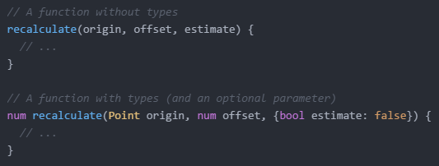
Whoa types?
Yes but don’t panic, they are optional

Slide 5
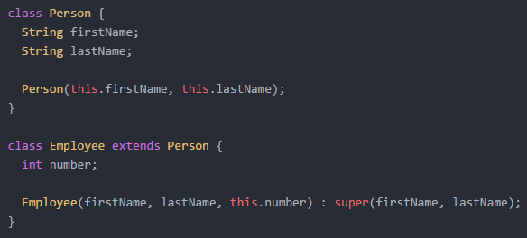
What About those other features?
Classes

Slide 6
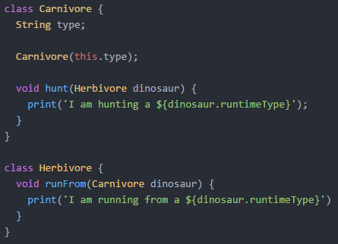
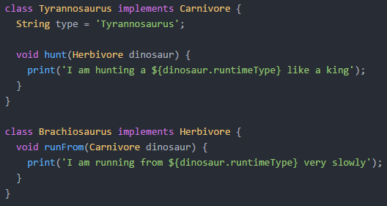
What About those other features?
Interfaces (implicit)

Slide 7
Those look like classes
Correct!
Because the interface is implicit, we still define a whole class
Had to define a type property on the Tyrannosaurus, is there a better way? (Yes)

Slide 8
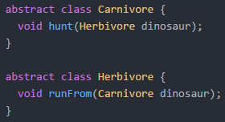
What About those other features?
Abstract classes

Slide 9
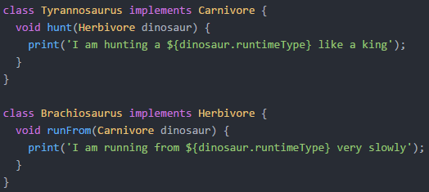
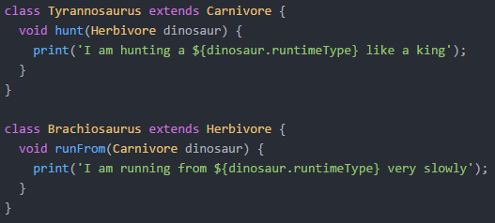

Slide 10
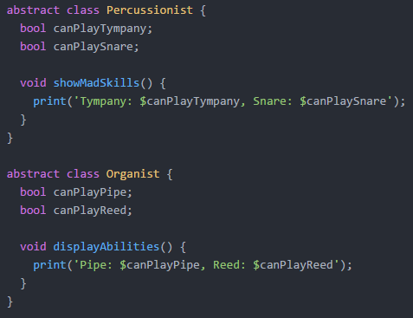
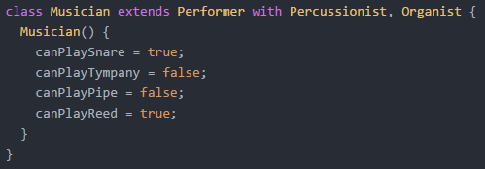
What About those other features?
Mixins

Slide 11
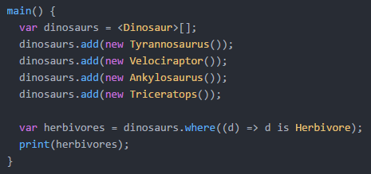
What About those other features?
Generics (pretty straightforward, but still cool)

Slide 12
Even more features
Libraries for modularity
Private variables
Lexical scope
Extensive libraries
Collections (List, Map, Set)
Browser functionality (dart:html)
Network functionality (http, socket)
Asynchrony (Futures, async/await)
Reflection (mirrors)
Concurrency (isolates)

Slide 13
Tools
Standalone VM
dart2js
Analyzing and Formatting
Profiling
Pub (package and asset manager)

Slide 14
What it isn’t
Replacement for JavaScript
Runs in VM in Dartium, but all other browsers require compilation into JavaScript
Compiles into highly optimized JavaScript, long term goal is to compile into Idiomatic (readable) JavaScript

Slide 15


So why are we here?
Web programming in Dart offers a couple of different options that can be used separately or together (which one should we discuss?)

Slide 16
History
Angular came onto the scene in 2010, AngularDart followed in 2013
Angular was ported to Dart, immediately used by an internal team at Google for sales force automation
Shipped the first version of that application in < 6 months

Slide 17
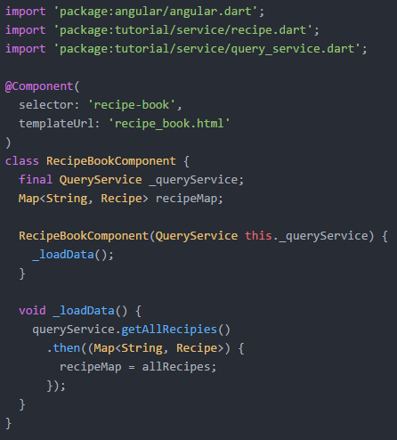
Angulardart 1.0

Slide 18
Angulardart 1.0
AngularDart became the basis of what Angular 2 is today
The mission became one “Angular” framework with language parity
Angular 2 is written in TypeScript, then compiled into JavaScript and Dart
UPDATE: There while be two Angular codebases (Dart and TS/JS) with a dedicated AngularDart team

Slide 19
DEMO time

Slide 20
So where do we go from here?
Dart has reached version 1.17
Angular 2 is in release candidate
Dart developer team has anointed Angular as “the” web framework for Dart

Slide 21
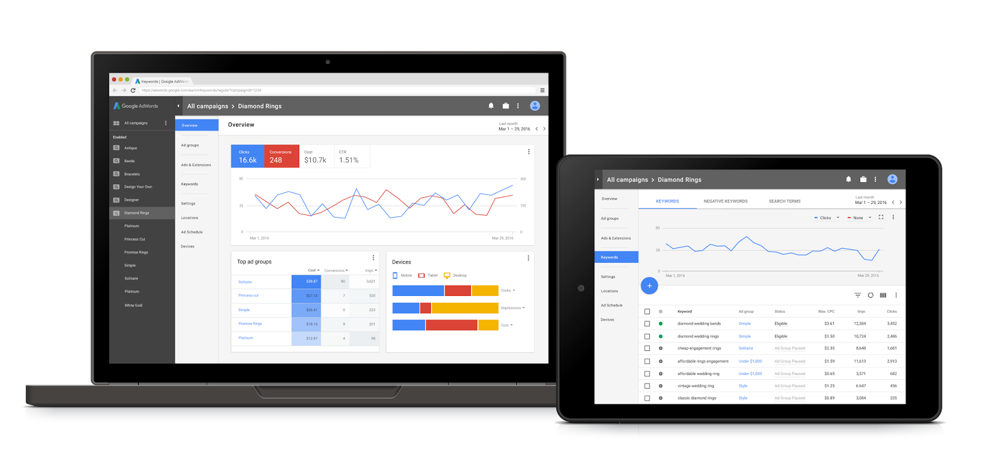
Why Dart now?

Slide 22
I’m ready to switch!
Slow down there!
Dart has a lot of pros, but there can be some cons
JavaScript interop is not simple
Dart has some good packages, but pales in comparison to JavaScript libraries
If you are familiar with JavaScript there can be a re-learning curve
Smaller community to lean on
Experienced JavaScript developer looking for a better solution => Evaluate
New to web development with no JavaScript knowledge => Yes
Looking to learn and play around with command line/server apps = Absolutely

Slide 23
Questions?

Slide 24
Resources
Dart – https://www.dartlang.org
Package Repo – https://pub.dartlang.org
Angular – https://angular.io/dart
Polymer-Dart – https://github.com/dart-lang/polymer-dart/wiki
DartPad – https://dartpad.dartlang.org
WebStorm – https://www.jetbrains.com/webstorm

